Slide 1
Connected System for Health and Environment in Smart Cities Setup
ThingsMesh

Slide 2
Why ?
It is estimated that outdoor air pollution was responsible for the deaths of 3.7 million people globally during 2012.
Short-term exposure to air pollution could increase a person's risk of irregular heart beat or blood clots in the lung, a new study has suggested.[1]

Slide 3
How ?
We want to create a system where we can add Air Quality nodes at different places of Cities.
We want to create a wearable device which can sense the heart parameters details.
All these data will be processed in Cloud (Thingspeak) to find insights ,predict and monitor health issues of a person.
Mobile Application to Visualize and find notifications.

Slide 4
What type of Predictions
Take a route which is best according to health.
Continuous track of Heart rate , analysed with machine learning techniques to predict the failure pattern of heart beat and advices to visit the Doctor.
Fitness Predictions.

Slide 5
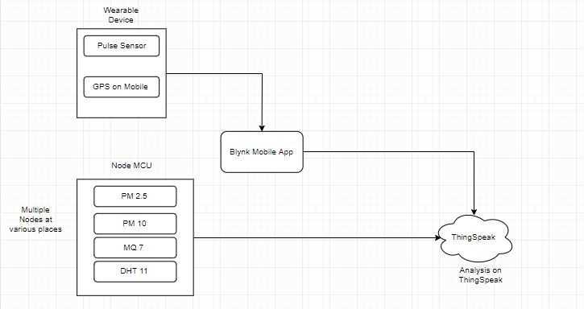
Block Diagram

Slide 6
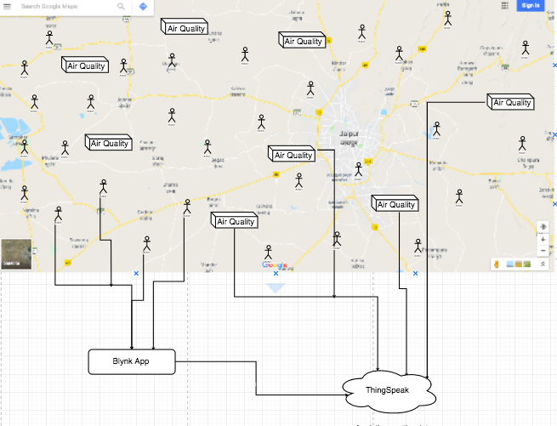
Map of Air Quality Nodes and Wearable Devices

Slide 7
Technology
ThingSpeak IOT Cloud Platform
Nodemcu Embedded Platform
Neural Network Analysis using NN Toolbox in Matlab
BLYNK IOT Cloud App

Slide 8
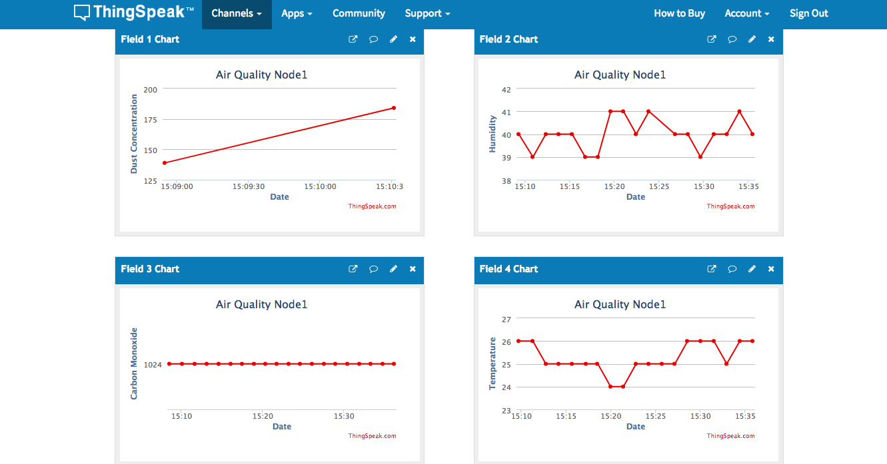
Plot sample values at ThingSpeak from Air Quality Node

Slide 9
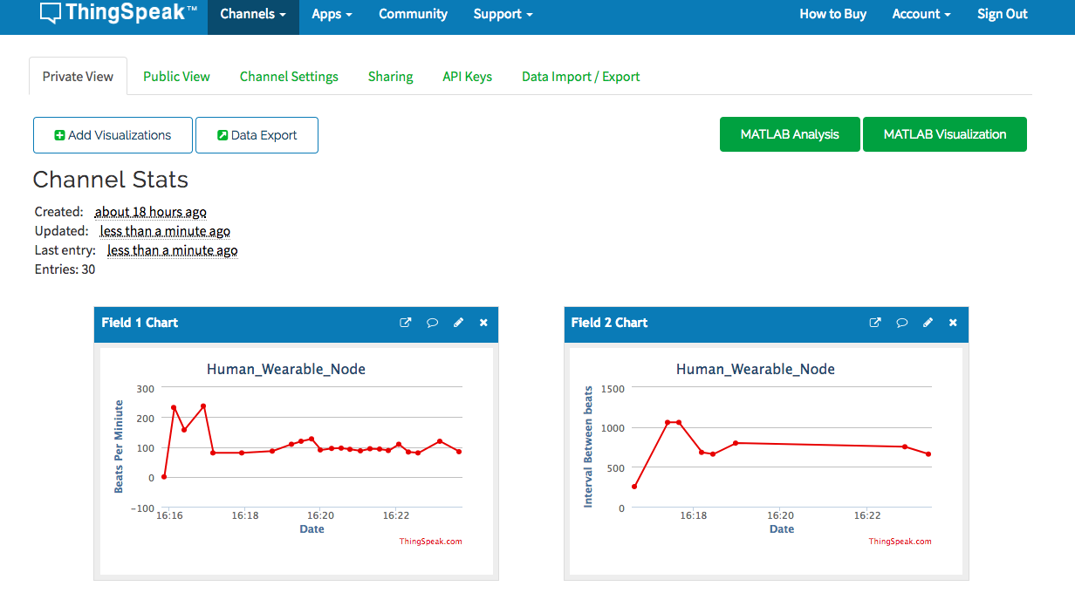
Plot sample values at ThingSpeak from Wearable Node
Initial Noisy Data

Slide 10
ML Analysis
We want to gather data from these sensors continuously. This gives us a Train Dataset.
Later we will test the accuracy with Neural Network Architecture.
Risk Factor for various routes based on Equation 1.

Slide 11
Risk factor for route(i)= Σ aq*td (from j=1 to m ,where m is total number of devices we can find in that particular route). We will analyze this for various routes and we find best route based on risk factor metric.
aq=air quality , td=traffic density (from google maps)

Slide 12
System Cost
Cost of Air Quality Node ~ 3000-4000 RS
Cost of Wearable Node ~ < 1000 RS

Slide 13
References
[1] https://www.theguardian.com/environment/2014/jun/05/air-pollution-linked-to-irregular-heart-beat-study-finds

